Slide 1

ETI Content Automation
Meizhi Hu @ Process & Quality

Slide 2

Agenda
Background
Process Before/ After Automation
Benefits & Challenges
Benefits analysis, challenges & Solutions
Architecture & Design
Progress & Demo
Q&A
Design a reliable, efficient, robust and flexible automation framework
Progress made and future plan
Overview
Task Viewer, Configuration Editor, Result Viewer and Timer

Slide 3
Background- A Real Case
Before Automation: Manual Data Collection
A Typical Case
Step 1. DA opens URL in browser
http://www.hkex.com.hk/eng/plw/plw_search.asp
Step2. Get web page source
Step3. Parsing and get information from page source
Step 4. Click to download a CSV / PDF file
Step 5. Parsing and get information from files
Step6. Update / generate target files( excel, txt…)
Row by row, cell by cell
Operations
Web: Browsing, searching, downloading, uploading, etc.
Data: Comparing, Parsing, Formatting, Filtering, etc.
Office: Opening, Modifying, Saving, etc.

Slide 4
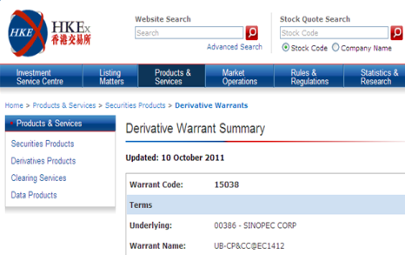

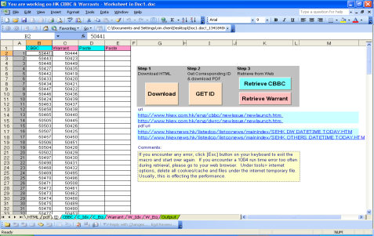
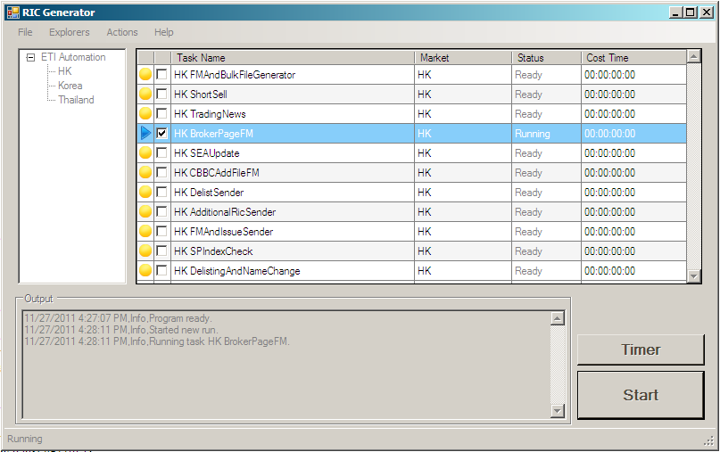
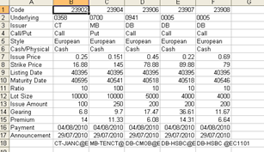
Background
Before
1. Go to the HK exchange website
2. Analyst downloads data and inputs data to template manually
After
1. Run tool
2. Files Output

Slide 5
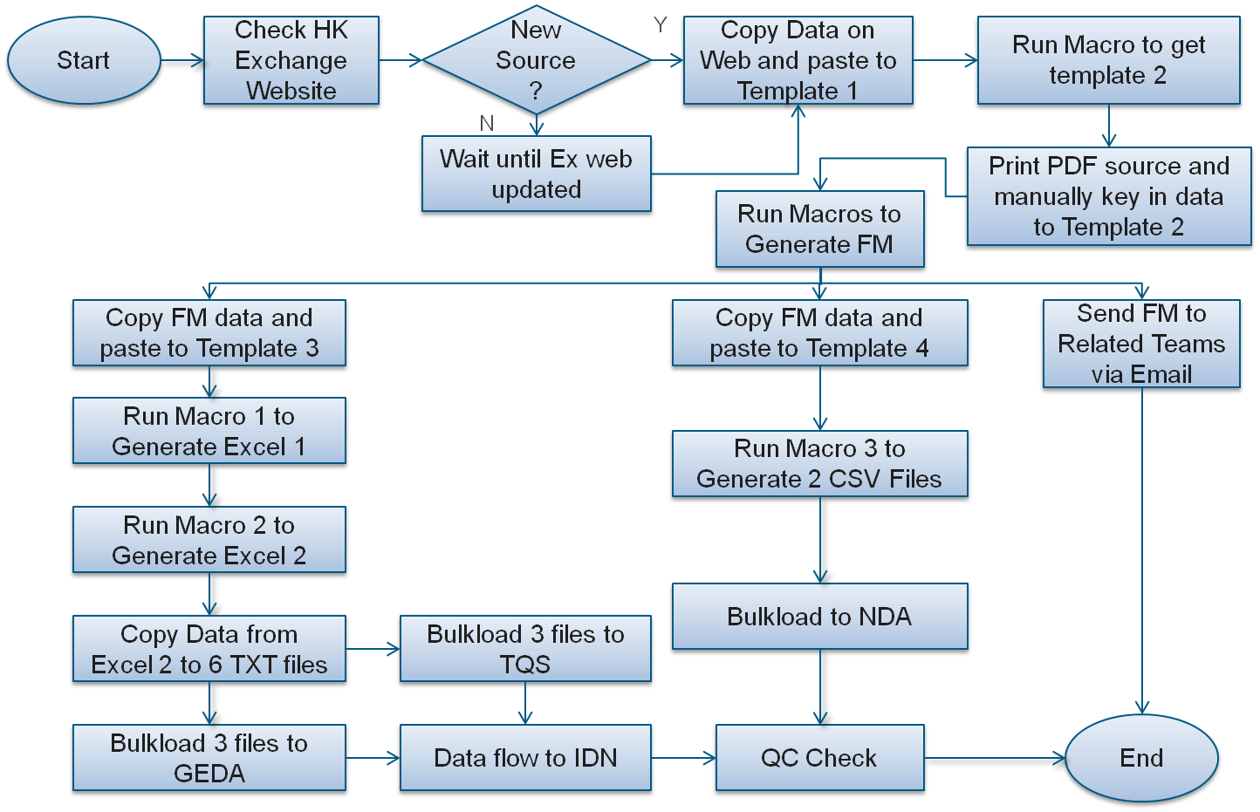
Background – Old Process

Slide 6
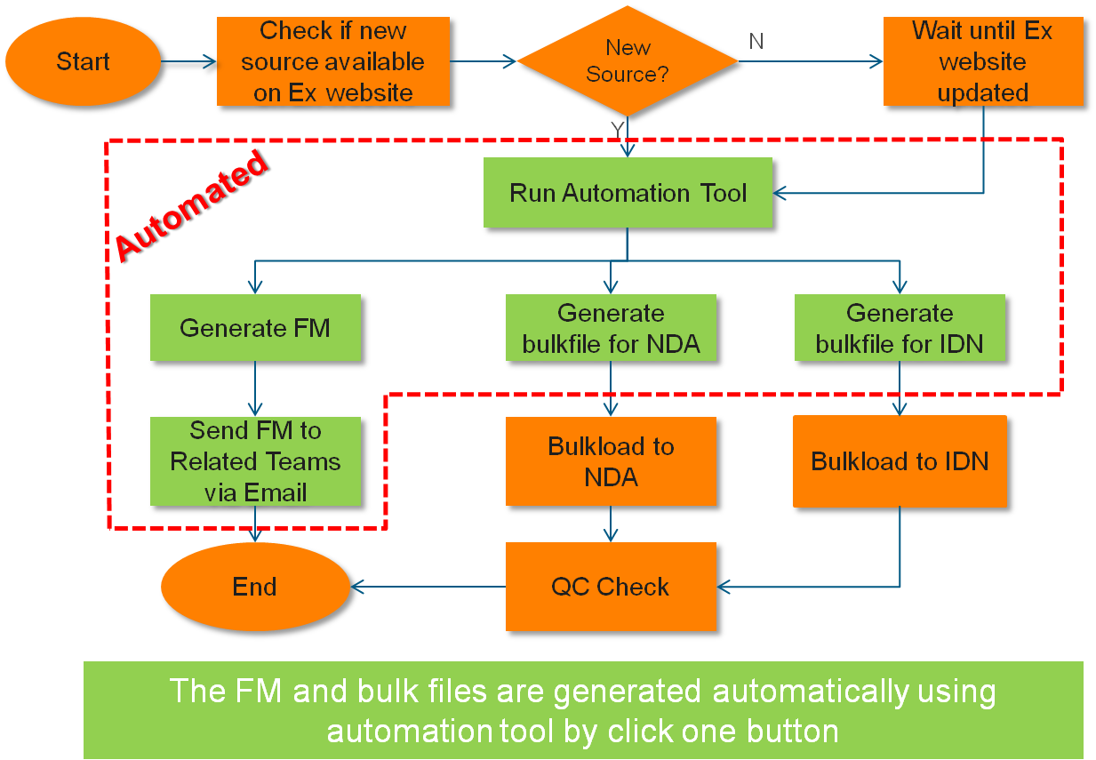
Background – New Process

Slide 7
Benefits Analysis (1)
Before Automation: Manual Data Collection
Slow
Repeated
Compromised data integrity and consistency
Expensive
…
ETI Content Automation:
Improve accuracy
Reduce efforts

Slide 8
Benefits Analysis (2)
Market | Cost of Doing Nothing (man-hours/Dataset in 1 Year <250 working day>) | Actual Cost after project (man-hours/Dataset in 1 Year<250 working day>) | Actual Project Benefit (man-hours in 1 Year <250 working day>, for all possible Dataset)
HK | $25,000 | $18,430 | $6,570
Korea | $8,000 (1 headcount) | $3,000 (0.4 headcount) | $5,000 (0.6 headcount)
Total Saved Per Year: 6570+5000 = ($)11570

Slide 9
Challenges & Solutions
Incremental / Changing User Requirements
Flexibility and Extensibility
Parser Maintenance
Robust Parser
Issue Reproducing and Recovery
Logging and Auto Recovering
Network Condition
Retrying

Slide 10
RicGenerator Overview
Tree-model in Task Organization
Market as branch
Task Scheduling
Immediate mode
Timer mode
Task Management
Configuration
Task Results
Task Status Tracking
Ready, Running, Completed, Failed
More…

Slide 11
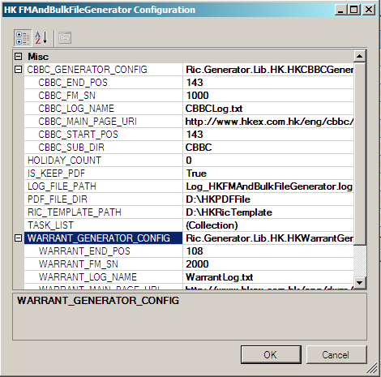
Configuration Editor
Each task has its own configuration editor to update parameters

Slide 12
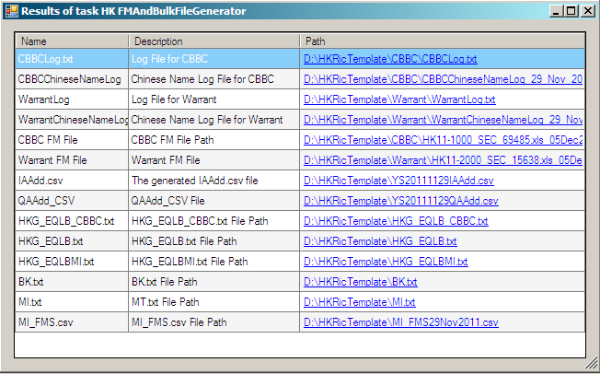
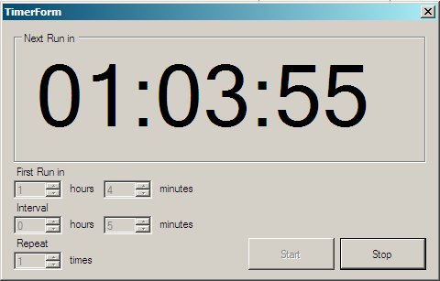
Scheduler&Result Viewer
Task Result Viewer
Task Scheduler
First Run
Interval
Repeat

Slide 13
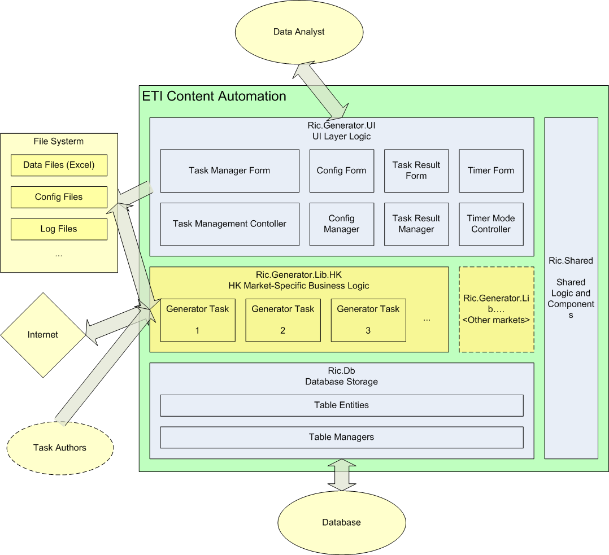
Architecture
High Level Design

Slide 14
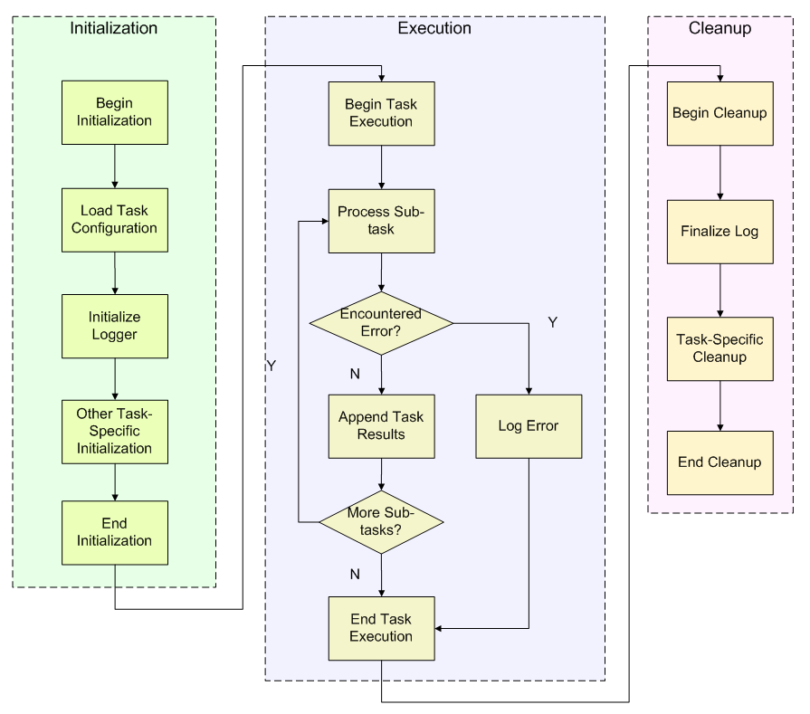
Architecture
Business Logic Workflow

Slide 15
Design – Principles (1)
Shared Components
Library building & encapsulation
Eliminate code forking
Maximum possible reuse
Business logic abstraction
Example: Ric.Shared namespace
AdvancedWebClient
Web crawling lib
ConfigUtil
Configuration hibernating
Excel Bundle
ExcelLineWriter, ExcelApp, ExcelUtil, etc.
Other
Outlook lib, Zip lib, ProcessContext, Logger, FileUtil, etc.

Slide 16
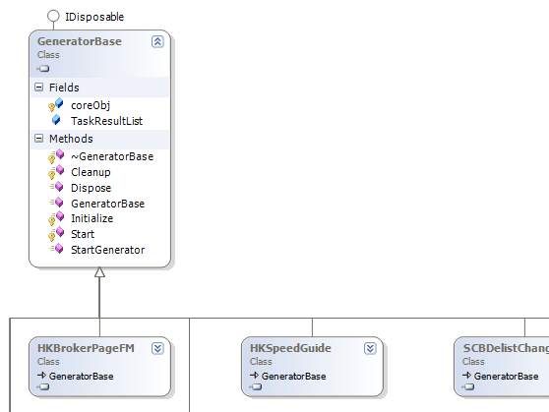
Design – Principles (2)
Unified Task Interface
Unified Interface, Different Implementation
UI and Business Logic Separation
Consistent Management
Configuration Management
Task Execution
Task Result Management

Slide 17
Techniques Adopted
Support Both WebClient + Selenium as Web Engine
Support Both XPath (HtmlAgilityPack) + Regular Expression as Parser
Xml Serialization / Deserialization Model for Configuration
Microsoft.Office.Interop for MS Office Automation
MySQL as DB Server

Slide 18
Progress (Framework)
Project
Hong Kong
Korea
Thailand
Japan
?
Framework
Build Framework
Add WebClient Support
New Configuration Interface
Regulate Task Interface
Created New UI
Add Visual Configuration Editor
Refractor Library
Add Task Result Viewer
Add DB Support
Add Parallel Execution Support
Dynamic Task Loading / Unloading
?
Done
In Progress
To Do

Slide 19
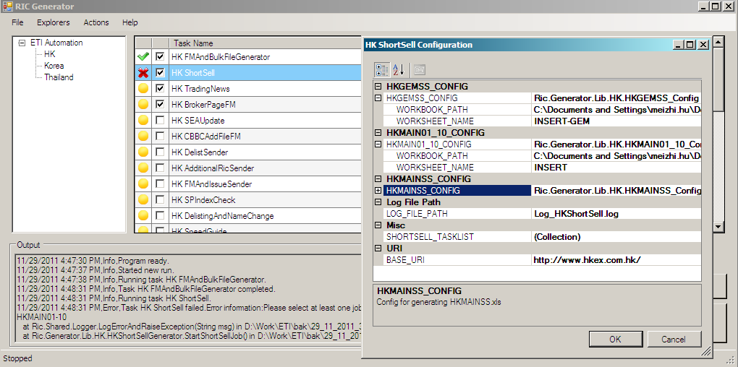
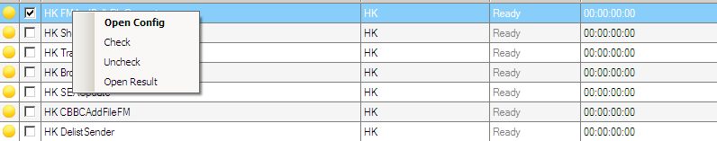
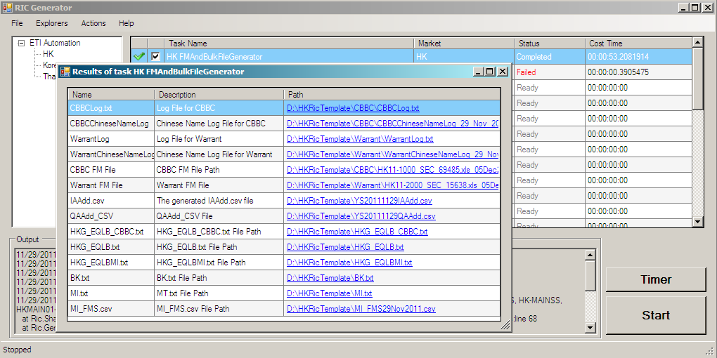
Demo
Ric Generator User Guide

Slide 20

Q & A

